Slide 1

Unit 6.2 - Data Integrity
Prepared by: Koh Kian Hua

Slide 2
Objectives
After completing this unit, students should be able to:
Describe how data validation and data verification help protect the integrity of data.
Describe and use methods of data validation including range check, format check, length check, presence check, existence check, limit check, check digit.
Describe and use methods of data verification during data entry (visual check, double entry) and data transfer including parity check (byte and block), checksum.

Slide 3
Data Integrity
Data Integrity
Data stored on a computer should always be accurate, consistent and up to date.
Two methods used to ensure data integrity are validation and verification.
The accuracy (integrity) of data can be compromised
  during the data entry and data transmission stages
  by malicious attacks on the data, for example caused by malware and hacking
  by accidental data loss caused through hardware issues.

Slide 4
Data Integrity
Data Validation
Data Validation: defined as the practice of checking the integrity, accuracy and structure of data before it is used for a business operation.
The most common types of data validation are
  type validation (eg: ensure non-numeric data is not input into numeric only field)
  range validation (eg: check data withn lower and upper limit: age should not be negative value)
  format validation (eg: data entered in agreed format, date should be dd/mm/yyyy)
  length validation (eg: check data has the required number of characters)
  presence validation (eg: check to ensure a data field is not left empty)
  existence validation (eg: check if data in database or file actually exists)
  limit check (eg: check the lower and upper limit of data, eg: age should not be negative value)
  consistency check (check data in two or more field matched correctly, eg: keying "Mrs" and choosing gender as "Female")
  uniqueness check (check that unique data such us Student_ID, Email_Address are not entered into system more than once)

Slide 5
Data Integrity
Data Verification
Data Verification: defined as the checking of the current data to ensure that it is accurate, consistent, and reflects its intended purpose.
Data verification can be done during data-entry using three methods
  Double entry (eg: data is entered twice by 2 different people and check after data entry )
  Visual check (eg: entered data is compared with the original document)
  Check digits (eg: additional digit added to a number in the righ most position to ensure that data is correctly inputted: commonly used in barcodes, Vehical Identification Number (VIN), ISBN-Internation Standard Book Number etc)

Slide 6
Data Integrity
Data Verification During Data Transfer
When data is transferred electronically from one device to another, there is always the possibility of data corruption or even data loss.
There is a number of ways to minimise this risk.
  Checksum
    a sum derived from the bits of a segment of computer data that is calculated before and after transmission or storage to assure that the data is free from errors or tampering
  Parity Checks
    a method for detecting errors in data communications or within a computer system by counting the number of ones or zeros per byte or per word, including a special check bit (parity bit)
  Automatic Repeat Request (ARQ)
    also known as automatic repeat query, is an error-control method for data transmission that uses acknowledgements and timeouts to achieve reliable data transmission over an unreliable communication channel

Slide 7
Data Integrity
Parity Bit (Parity Checks)
A parity bit is a check bit, which is added to a block of data for error detection purposes.
  It is used to validate the integrity of the data.
  The value of the parity bit is assigned either 0 or 1 that makes the number of 1s in the message block either even or odd depending upon the type of parity.
Parity check is suitable for single bit error detection only.
The two types of parity checking are
  Even Parity : Here the total number of bits in the message is made even.
  Odd Parity: Here the total number of bits in the message is made odd.

Slide 8
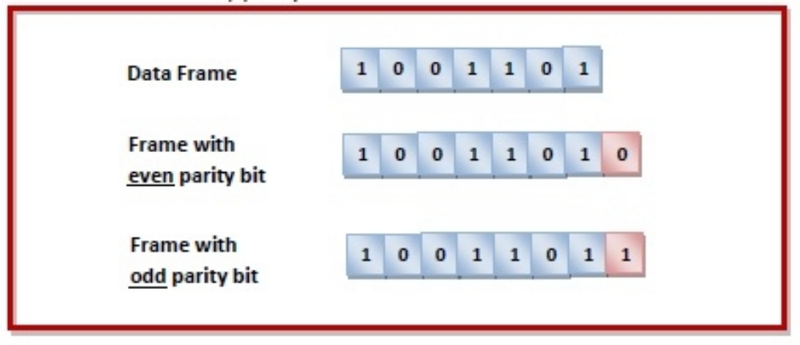
Data Integrity
Error Detection Using Parity Bit
Sender’s End − While creating a frame, the sender counts the number of 1s in it and adds the parity bit in following way
  In case of even parity − If number of 1s is even, parity bit value is 0. If number of 1s is odd, parity bit value is 1.
  In case of odd parity − If number of 1s is odd, parity bit value is 0. If number of 1s is even, parity bit value is 1.
Receiver’s End − On receiving a frame, the receiver counts the number of 1s in it.
  In case of even parity check, if the count of 1s is even, the frame is accepted, otherwise it is rejected.
  In case of odd parity check, if the count of 1s is odd, the frame is accepted, otherwise it is rejected.

Slide 9
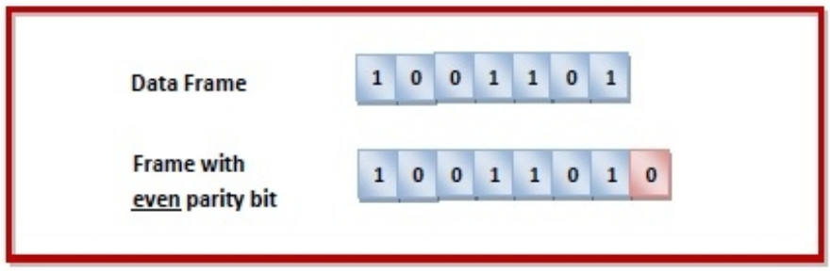
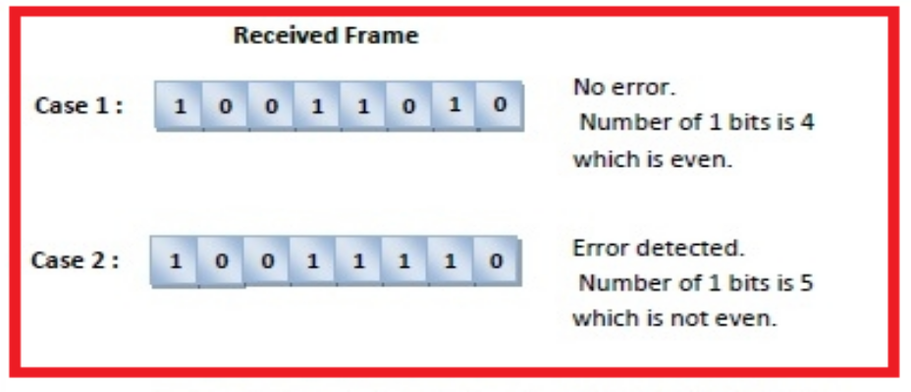
Data Integrity
Parity Bit (Example)
If a sender wants to send the data 1001101 using even parity check method. It will add the parity bit as shown below.
The receiver decides whether error has occurred by counting whether the total number of 1s is even. This is illustrated as follows

Slide 10
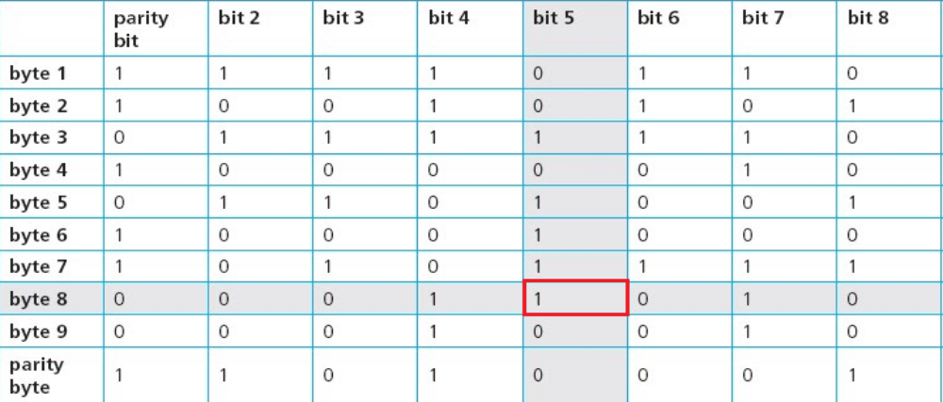
Data Integrity
Parity Block
This method of error checking is similar to a traditional parity check except the data is arranged in a virtual table with parity bits added to each row and column.
A single corrupted bit can be spotted at the intersection of a corrupted row and column.
Multiple corrupted bits would also flaw this system.

Slide 11
Data Integrity
Automatic Repeat Request (ARQ)
Automatic repeat request (ARQ) is another method to check data following data transmission.
This method can be summarised as follows:
  ARQ uses acknowledgement and timeout (the time interval allowed to elapse before an acknowledgement is received).
  When the receiving device detects an error following data transmission, it asks for the data packet to be re-sent.
  If no error is detected, a positive acknowledgement is sent to the sender.
  The sending device will re-send the data package if
    it receives a request to re-send the data, or
    a timeout has occurred.
  The whole process is continuous until the data packet received is correct or until the ARQ time limit (timeout) is reached.
  ARQ is often used by mobile phone networks to guarantee data integrity.

Slide 12
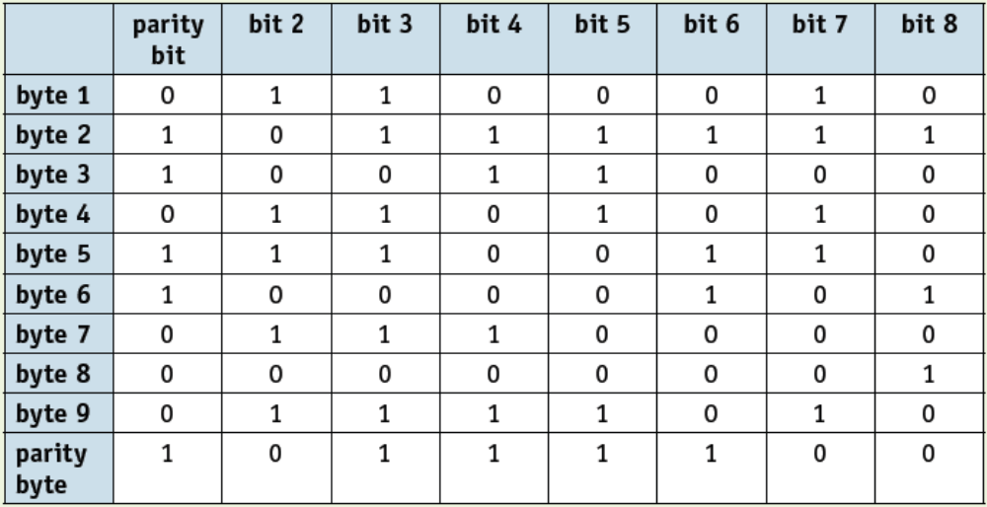
Data Integrity
Class Activity
The following block of data was received after transmission from a remote computer.
Odd parity was being used by both sender and receiver.
One of the bits has been changed during the transmission stage.
Locate where this error is and suggest a corrected byte value:

